Slide 1


VERIFICATION
&
AUTHENTICATION
OF CERTIFICATES
SOLUTION

Slide 2
(VAC) SERVICES
Verification and Authentication of Academic Certificates and Transcripts.
NSPM would deploy resources to streamline and automate the process of verifying and authenticating certificates and transcripts.
NSPM will invest in building datacenter to assist Institutions that can not invest hugely in storing academic results in electronic form.
NSPM will assist in scanning results not yet in electronic form unto the database at no cost to the partnering Institution.
Ownership and control of graduates’ results will still be within the control of the Institutions.
A portal will be provided with log in opportunity for interested parties who want to verify results.
Dashboard will be available on the platform to monitor number of results verified daily for transparency, audit control and revenue monitoring.
A Memorandum of Understanding will be signed by the Institution and NSPM to protect both parties before commencement of project.
Subsequent certificates to be printed by NSPM will have QR codes that upon accessed can easily take would be verifier to the verification portal.
Revenue sharing by the Institution and NSPM would be agreed to by both parties in the MOU.
Partnering Institution will have a wider reach by collaborating with NSPM.

Slide 3
(VAC) SERVICES cont’d
Verification and authentication of academic certificates and transcript.
The VAACT system automates the process of verifying and authenticating certificates.
It provides a faster turnaround time in the process and foster efficiency.
It eliminates human error and fraud that could lead to litigations against the Institutions as a result of the manual feedback process.
It requires less manpower to manage when compared to the manual process.
Ensure comprehensive protection of data in transit.
the certificate verification process is a source of revenue for the Institutions.
Allow Institutions to reallocate resources to other student focused activities, hereby reduce cost of operations.
It stops financial extortion by unauthorized staff of the institutions.

Slide 4
VAC SERVICE USERS
Employers within and outside Nigeria.
Higher institutions of learning within and outside Nigeria.
Professional bodies within and outside Nigeria.
Embassies and High Commissions within and outside Nigeria.
Security Operatives in Nigeria like DSS who vet results of electoral candidates seeking political office.

Slide 5

Verification & Authentication Process
An easy-to-use authentication system.
Individuals and corporations can verify these certificates at anytime and from any device (PC or Mobile).
Each certificate comes with a QR-Code and a unique identifier.
These certificates can also be tied to the holder’s National Identity Number (NIN).
Search criteria could be from the Matriculation Number, NIN, Unique Number on each certificates.
The system is built for ease-of-use and accessibility.
Payments will be made on the portal through accredited payment platforms.

Slide 6
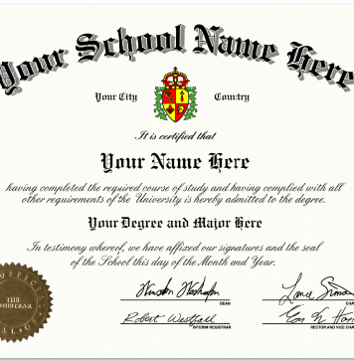
Certificates
The MINT produces imitation-proof certificates for its clients in various industries.
Our production procedures are tailored to meet our clients’ strict specifications. We also take into consideration the degree of sensitivity and use of these certificates.
Our production systems ensure that these certificates are preserved against fraud, counterfeiting, and identity theft.
Our Certificates come with Multi-Layered Security features of both overt and covert features.
We print with a high grammage security paper customized exclusively to Nspm and can not be bought across the shelf by fraudster.
Highly
Secure

Slide 7
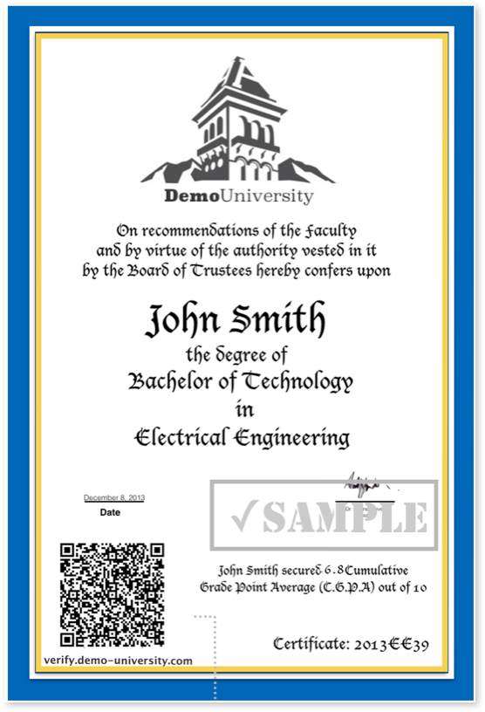
Digitalized Certificates
The degree certificate awarded by the University is of prime importance in the person’s life but the production and circulation of fake certificates can be forged with the availability of advance printing and copying technologies.
In order to prevent the circulation of fake degree certificates, NSPM is proposing a Digitalized Certificate where the integrity of the contents within the certificate can be verified with the use of Technology.
We produce QR code-based degree certificates. This offers an extra level of security to these certificates.
Facsimile signatures of authorized signatories are captured and replicated on the certificates to prevent boring signings of volume certificates.
Customized information of each graduate is captured in a secured format and replicated on each certificate accordingly.
It meets global acceptance.
QR Code
07

Slide 8

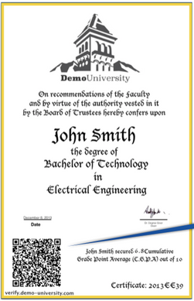
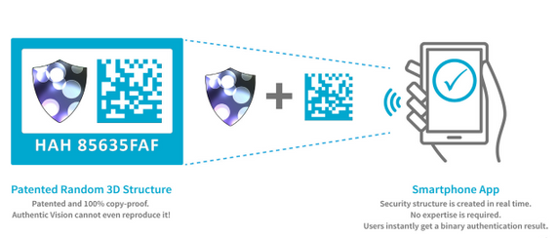
Digitalized Certificates
Two simple but highly effective and complimentary products to combat counterfeiting.
Authentication / Certificate Verification Web Portal
01
Secure Tags/Labels Printing
02
Unique security tags containing random structures that are so secure that they could not be reproduced.
An easy-to-use authentication system that would be deployed via the web and smart phone.

